Slide 1
The internet and Internet services
Unit 8

Slide 2
Internet:
The Internet is the global system of interconnected computer networks that use the Internet protocol suite (TCP/IP) to link devices worldwide. It is a network of networks that consists of private, public, academic, business, and government networks of local to global scope.
The Internet carries a vast range of information resources and services, such as WWW, electronic mail, e-commerce, and file sharing etc.

Slide 3
Internetworking protocol(TCP/IP)
TCP/IP, or the Transmission Control Protocol/Internet Protocol, is a suite of communication protocols used to interconnect network devices on the internet.
TCP defines how applications can create channels of communication across a network. It also manages how a message is assembled into smaller packets before they are transmitted over the internet and reassembled in the right order at the destination address.
IP defines how to address and route each packet to make sure it reaches the right destination. Each gateway computer on the network checks this IP address to determine where to forward the message.

Slide 4
The internet Architecture:
A brief description of the architecture of Internet is as follows:
Client at home or in a LAN network is at the lowest level in hierarchy.
Local ISP is at the next higher level
Regional ISP is next in the hierarchy. The local ISP is connected to regional ISP.
Backbone is at top of the hierarchy.

Slide 5
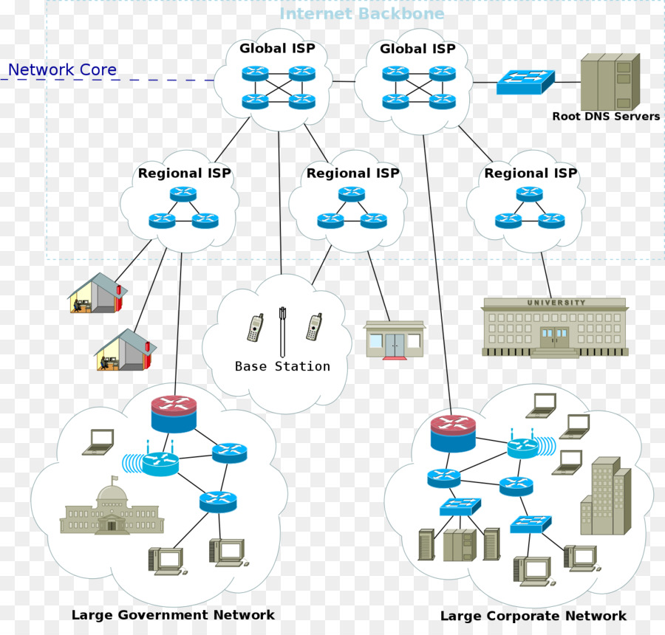
Fig of internet architecture

Slide 6
Managing the internet:
Internet is not controlled by any one person or an organization. A number of organizations manage the internet, which are given below.
ICANN(Internet Corporation for Assigned Names and Numbers) it oversees the assignment of globally unique identifiers on the Internet, including domain names, Internet protocol addresses.
Internet Activities Board (IAB) - The technical body that oversees the development of the Internet suite of protocols.
Internet Engineering Task Force (IETF) - Develops and maintains the Internet’s communication protocols.
Internet Research Task Force (IRTF) - Look into long-term research problems that could be critical in five or ten years.
Internet Network Information Center (InterNic) - The purpose is to provide the various registry services needed for the Internet to operate effectively.
World Wide Web Consortium (W3C) - develop standards for the evolution of the Web.

Slide 7
Connecting to the internet:
To connect your computer to the Internet, you require-
A computer
A modem and telephone line
An Internet browser software
An account with an Internet Service Provider (ISP)

Slide 8
Different Types of Internet Connections
There are many ways a personal electronic device can connect to the internet. They all use different hardware and each has a range of connection speeds. Different Types of Internet Connections are given below:
1) Dial-Up :
Dial-up access is cheap but slow. A modem (internal or external) connects to the Internet after the computer dials a phone number. This analog signal is converted to digital via the modem and sent over a land-line serviced by a public telephone network. The lines regularly experience interference and this affects the speed, anywhere from 28K to 56K. Since a computer or other device shares the same line as the telephone, they can’t be active at the same time.

Slide 9
2) DSL: DSL stands for Digital Subscriber Line. It is an internet connection that is always “on”. This uses 2 lines so your phone is not tied up when your computer is connected. There is also no need to dial a phone number to connect. DSL uses a router to transport data and the range of connection speed, depending on the service offered, is between 128K to 8 Mbps.
3) Cable: Cable provides an internet connection through a cable modem and operates over cable TV lines. Since the coax cable provides a much greater bandwidth over dial-up or DSL telephone lines, you can get faster access. Cable speeds range from 512K to 20 Mbps.

Slide 10
4) Wi-Fi: As the name suggests, does not use telephone lines or cables to connect to the internet. Instead, it uses radio frequency. Wireless is also an always on connection. Speeds will vary, and the range is between 5 Mbps to 20 Mbps.
5) Cellular : Cellular technology provides wireless Internet access through cell phones. The speeds vary depending on the provider, but the most common are 3G and 4G speeds. A 3G is a term that describes a 3rd generation cellular network obtaining mobile speeds of around 2.0 Mbps. 4G is the fourth generation of cellular wireless standards. The goal of 4G is to achieve peak mobile speeds of 100 Mbps but the reality is about 21 Mbps currently.

Slide 11
Services of internet:
The services of internet are given below
WWW: World Wide Web (WWW)- WWW is also known as W3. It offers a way to access documents spread over the several servers over the internet. These documents may contain texts, graphics, audio, video, hyperlinks. The hyperlinks allow the users to navigate between the documents.
Electronic Mail- It is used to send and receive electronic message over the internet.
E-commerce- It is the process of buying and selling goods through internet.
Video Conference- It is a live, visual connection between two or more people residing in separate locations for the purpose of communication.

Slide 12
Telnet(Telecommunication Network) Used to log on to a remote computer that is attached to internet.
Newsgroup Offers a forum for people to discuss topics of common interests.
Internet Relay Chat (IRC) Allows the people from all over the world to communicate in real time.
Internet Telephony (VoIP) Allows the internet users to talk across internet to any PC equipped to receive the call.
File Transfer Protocol (FTP) It Enable the users to transfer files. It helps user to upload and download the files.

Slide 13
Uses of Internet:
Uses of Internet in Students daily life
Uses of Internet to increase the speed of daily tasks
Uses of the Internet for business promotion and innovation
Uses of Internet for shopping in our daily life
Use of Internet for research and development
Use of Internet provide us quick and free communication
International uses of Internet by working remotely and providing business services
Uses of the Internet in Money Management
Uses of the Internet in Everyday Politics
Uses of Internet for Teaching and Sharing Knowledge with others

Slide 14
E-mail(Electronic-mail):
It is the process of sending and receiving message through internet. It is the important service of internet. The two protocol used in e-mail are SMTP, POP3.
Advantages of Email:
Emails are delivered extremely fast when compared to traditional post
Emails can be sent 24 hours a day, 365 days a year.
Emails can be sent and received from any computer, anywhere in the world, that has an Internet connection.
It is cheaper than traditional mail system.
Emails can be sent to one person or several people at once.
There is always a record of the exact conversation in an email until deleted.
People don't have to be present to receive the email.
It is versatile. Messages, photos, audio, videos etc can be sent easily and not need to pay extra charge as in postal mail.

Slide 15
Disadvantages of Email:
The recipient needs access to the Internet to receive email.
Viruses are easily spread via email attachments.
Email is used for phishing.
Minor mistake can deliver the email to wrong address.

Slide 16
Internet service provider:
An Internet service provider (ISP) is a company that provides customers with Internet access. Data may be transmitted using several technologies, including dial-up, DSL, cable modem, wireless or dedicated high-speed interconnects.
ISP of Nepal are World Link, Ncell, NTC, mercantile, web surfer etc.

Slide 17
Domain Name
A domain name is a human-readable address used to identify a website or resource on the internet. It simplifies access to web resources by replacing numerical IP addresses with easy-to-remember names.
No two organizations have the same domain. A domain name usually has two parts separated by periods called dot. Eg facebook.com, youtube.com etc.

Slide 18
Domain name server:
A Domain Name Server is a system or server that translates domain names into their corresponding IP addresses. This translation is necessary because computers access websites using IP addresses, not domain names.
The numeric address, called the IP(Internet Protocol) address, is actually the “real” URL. Since numeric strings are difficult for humans to use, alphanumeric addresses are employed by end users. Once the translation is made by the DNS, the browser can contact the Web server and ask for a specific file located on its sites.

Slide 19
Example
A user types google.com into their browser.
The DNS translates google.com to an IP address, such as 172.217.0.46,
allowing the browser to connect to the correct server.

Slide 20
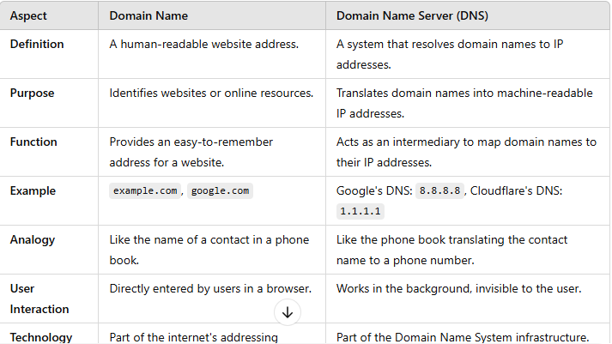

Slide 21
Internet address:
An Internet Protocol address (IP address) is a numerical label assigned to each device connected to a computer network that uses the Internet Protocol for communication. It is also called logical address. IP addresses are unique. No two machines can have the same IP number.
IPv4 uses 32-bit addresses, which limits the address space to 4,294967296 possible unique addresses . Each section contains a number ranging from 0 to 255. Eg 192.168.3.50
IPv6 uses 28-bit addresses. It consists of eight groups of four hexadecimal digits separated by colons. E.g. 2001:0dc4:3465:bc32:4573:8ag2:954d:232c

Slide 22
Protocol:
A protocol is a set of rules and guidelines for communicating data. Rules are defined for each step and process during communication between two or more computers. Networks have to follow these rules to successfully transmit data.
Example: HTTP,HTTPS,FTP,SMTP,TCP,IP,UDP etc.

Slide 23
HTTP
HTTP (Hypertext Transfer Protocol) is the set of rules for transferring files (text, graphic images, sound, video, and other multimedia files) on the World Wide Web. As soon as a Web user opens their Web browser, the user is indirectly making use of HTTP. HTTP is an application protocol that runs on top of the TCP/IP model.
An HTTP session begins when a client’s browser requests a resource, such as a web page, from a remote Internet server. When the server responds by sending the page requested, the HTTP session for that object ends.

Slide 24
FTP
File Transfer Protocol(FTP) is one of the original Internet services. FTP runs in TCP/IP’s Application layer and permits users to transfer files from a server to their client computer, and vice versa. The files can be documents, programs, or large database files.
Using FTP we can easily upload and download files and distribute files on the internet with each other.

Slide 25
SMTP
Simple Mail Transfer Protocol(SMTP) is the Internet protocol used to send e-mail to a server. To retrieve e-mail from a server, the client computer uses Post Office Protocol version 3(POP3).

Slide 26
TCP/IP
Transmission Control Protocol(TCP/IP) which has become the core communications protocol for the Internet.
TCP establishes the connections among sending and receiving Web computers, and makes sure that packets sent by one computer are received in the same sequence by the other, without any packets missing.
IP provides the Internet’s addressing scheme and is responsible for the actual delivery 0f the packets.

Slide 27
UDP
UDP (User Datagram Protocol) is an alternative communications protocol to Transmission Control Protocol (TCP) .
There are important differences between the TCP and UDP protocol:
Where UDP enables process-to-process communication, TCP supports host-to-host communication. TCP sends individual packets and is considered a reliable transport medium; UDP sends messages, called datagrams, and is considered a best-effort mode of communications.
In addition, where TCP provides error and flow control, no such mechanisms are supported in UDP. TCP is considered as connection oriented protocol but UDP is considered a connectionless protocol because it doesn't require a virtual circuit to be established before any data transfer occurs.

Slide 28
Telnet(Telecommunication Network)
Telnet is a networking protocol used to access remote computers over the Internet or a TCP/IP computer network.

Slide 29
World Wide Web(WWW):
The World Wide Web (WWW) is combination of all resources and users on the Internet that are using the Hypertext Transfer Protocol (HTTP).
The Web is a communications model that, through HTTP, enables the exchange of information over the internet.
Tim Berners-Lee is the inventor of the Web and the director of the W3C, the organization that oversees its development. Berners-Lee developed hypertext, that supports communications on the Web, making it easy to link content on one web page to content located elsewhere.

Slide 30
URL
A Uniform Resource Locator(URL), which is the address used by a web browser to identify the location of content on the web.
Example: http://www.facebook.com/login.html

Slide 31
Web server:
A web server is a system that delivers content or services to end users over the internet. A web server consists of a physical server, server operating system (OS) and software used to facilitate HTTP communication.

Slide 32
Web browser:
A browser is a software, which allows users to access and navigate the World Wide Web.
Example: Mozilla firefox, Google chrome, Internet Explorer etc.

Slide 33
Search engine:
Search engine is a service of internet that allows Internet users to search for content via the World Wide Web (WWW). A user enters keywords or key phrases into a search engine and receives a list of Web content results in the form of websites, images, videos or other online data. The list of content returned via a search engine to a user is known as a search engine results page (SERP). E.g. Google, yahoo, AltaVista etc.

Slide 34
Internet of Things (IoT)
Internet of Things (IoT) is a system of interconnected objects, usually called smart devices, through the Internet. That is objects that have been assigned an IP address and have the capability to collect and transfer data over a network. The objects interact with the external environment with the help of embedded technology, which helps them in taking decisions. Example of IoT are connected security systems, thermostats, cars, electronic appliances, lights in household and commercial environments, speaker systems, vending machines(machine that accepts money)
Some communication devices in IoT:
Sensors: Devices which converts physical parameters like temperature, motion etc… into the electrical signals .
Actuators: Devices which is a contrast to sensors. It transforms electrical signals into physical movements.
RFID Tags (Radio-frequency identification) : Wireless microchips used for automatic unique identification of anything by tagging it over them. You have been seen it in credit cards, automobile ignition keys and so on.

Slide 35
Characteristics of IoT:
Connectivity. Devices, sensors, they need to be connected to an item, to each other, actuators, a process and to ‘the Internet’ or another network.
Things. Anything that can be tagged or connected as such as it’s designed to be connected. From sensors and household appliances to tagged livestock(domestic animals). Devices can contain sensors or sensing materials can be attached to devices and items.
Data. Data is the glue of the Internet of Things, the first step towards action and intelligence.
Communication. Devices get connected so they can communicate data and this data can be analyzed.
Intelligence. The aspect of intelligence as in the sensing capabilities in IoT devices and the intelligence gathered from data analytics (also artificial intelligence).
Action. The consequence of intelligence. This can be manual action, automation.

Slide 36
Wearable Computing:
The terms “wearable technology“, “wearable devices“, and
“wearables” all refer to electronic technologies or computers that
are incorporated into items of clothing and accessories which can
comfortably be worn on the body. These wearable devices can
perform many of the same computing tasks as mobile phones and
laptop computers; however, in some cases, wearable technology
can outperform these hand-held devices entirely. Wearable
technology tends to be more sophisticated than hand-held
technology on the market today because it can provide sensory
and scanning features not typically seen in mobile and laptop
devices, such as biofeedback and tracking of physiological
Function. Example are Smart watches, Google glass etc.

Slide 37
Features of Wearable Computer:
Consistency: The computer runs continuously and is user friendly. Unlike, a hand held devise like tablets or laptops, it does not need to be opened up and turned on prior to its use.
Enhancement: The assumption of the wearable computing is that the user will be doing something else along with computing.
Mediation: Wearable computing acts as a mediator as it aids its users by providing its umpteen(large) applications in medical care, domestic use, corporate world, military etc.
Privacy: Wearable computing can be used to create a new level of privacy because it is much more personal as it is worn
Convenient: Wearable technology is of utmost convenience to the user as the right person can use it at the right time and at the right place which offers a great comfort zone and helps to increase its overall utility.
Unrestrictive: Wearable devices enable a person to do multi tasking and do not restrict the focus of a person to one particular thing.

Slide 38
Cloud computing
Cloud computing is the on-demand delivery of compute power, database storage, applications, and other IT resources through a cloud services platform via the internet with pay-as-you-go pricing.
Example google drive, drop box etc.

Slide 39
Advantages of Cloud Computing
Pay when you consume computing resources -Instead of having to invest heavily in data centers and servers before you know how you’re going to use them, you can only pay when you consume computing resources, and only pay for how much you consume.
Benefit from massive economies of scale -By using cloud computing, you can achieve a lower variable cost than you can get on your own.
Stop guessing capacity -Eliminate guessing on your infrastructure capacity needs. You can access as much or as little as you need, and scale up and down as required with only a few minutes notice.
Increase speed and agility - In a cloud computing environment, new IT resources are only ever a click away. This results in a dramatic increase in agility(quickness) for the organization, since the cost and time it takes to experiment and develop is significantly lower.
Stop spending money on running and maintaining data centers -Focus on projects that differentiate your business, not the infrastructure. Cloud computing lets you focus on your own customers, rather than on the heavy lifting of racking, stacking and powering servers.
Go global in minutes -Easily deploy your application in multiple regions around the world with just a few clicks. This means you can provide a lower latency(delay) and better experience for your customers simply and at minimal cost.

Slide 40
Cloud Computing Models
Infrastructure as a Service (IaaS): It contains the basic building blocks for cloud IT and typically provide access to networking features, computers , and data storage space. Infrastructure as a Service provides you with the highest level of flexibility and management control over your IT resources and is most similar to existing IT resources that many IT departments and developers are familiar with today.
Platform as a Service (PaaS): Platforms as a service remove the need for organizations to manage the underlying infrastructure (usually hardware and operating systems) and allow you to focus on the deployment and management of your applications.
Software as a Service (SaaS): Software as a Service provides you with a completed product that is run and managed by the service provider. In most cases, people referring to Software as a Service are referring to end-user applications. With a SaaS offering you do not have to think about how the service is maintained or how the underlying infrastructure is managed.

Slide 41
E-commerce:
It is the process of buying and selling products or services through the internet is called e-commerce.

Slide 42
Advantages of Ecommerce
Faster buying/selling procedure, as well as easy to find products.
Buying/selling 24/7.
More reach to customers, there is no theoretical geographic limitations.
Low operational costs and better quality of services.
No need of physical company set-ups.
Easy to start and manage a business.
Customers can easily select products from different providers without moving around physically.
Disadvantages of Ecommerce
Any one, good or bad, can easily start a business. And there are many bad sites which eat up customers’ money.
There is no guarantee of product quality.
Mechanical failures can cause unpredictable effects on the total processes.
As there is minimum chance of direct customer to company interactions, customer loyalty is always on a check.
There are many hackers who look for opportunities, and thus an ecommerce site, service, payment gateways, all are always prone to attack.

Slide 43
Types of e-commerce:
Business-to-Consumer (B2C): The Business-to-Consumer e-Commerce is related to the transactions and relationship between businesses and the end customers. This is mainly to do with the retail e-Commerce trade that takes place online. With the inception of the internet, B2C e-Commerce has evolved to a great extent. Today, we find scores of electronic shopping sites and virtual stores on the web, that sell myriad(many) products, ranging from computers, fashion items to even necessities. E.g. amazon.com
In this case, the customer has more info about the products in the form of informative content and there is also a chance to buy products at cheaper rates. Most times, quick delivery of the order is also maintained.
Business-to-Business (B2B): Business-to-Business (B2B) e-commerce encompasses all electronic transactions of goods or services conducted ​​between companies. Producers and traditional commerce wholesalers typically operate with this type of e-commerce. E.g. microsoft.com, buyerzone.com etc.

Slide 44
Consumer-to-Consumer (C2C): Consumer-to-Consumer (C2C) type e-Commerce encompasses all electronic transactions of goods or services conducted ​​between consumers. Generally, these transactions are conducted through a third party, which provides the online platform where the transactions are actually carried out. E.g. eBay.com
Consumer-to-Business (C2B): In this, a complete reversal of the selling and buying process takes place. This is very relevant for crowd sourcing projects. In this case, individuals make their items or services and sell them to companies. Some examples are proposals for company site or logo, royalty free photographs, design elements and so on. E.g. priceline.com

Slide 45
e-Governance
e-Governance is basically associated with carrying out the functions and achieving the results of governance through the utilization of ICT (Information and Communications Technology).
Goals of e-Governance:
 Better service delivery to citizens
 Ushering(escort) in transparency and accountability
 Empowering people through information
 Improved efficiency within Governments
 Improve interface with business and industry.
Reduced corruption.
Growth in GDP(Gross domestic product)

Slide 46
Types of e-government:
1. Government-to-Citizen(G2C)
The Government-to-citizen refers to the government services that are accessed by the familiar people. And Most of the government services fall under G2C. Likewise, the primary goal of Government-to-citizen is to provide facilities to the citizen. It helps the ordinary people to reduce the time and cost to conduct a transaction. A citizen can have access to the services anytime from anywhere.
Furthermore, Many services like license renewals, and paying tax are essential in G2C. Likewise, spending the administrative fee online is also possible due to G2C. The facility of Government-to-Citizen enables the ordinary citizen to overcome time limitation. It also focuses on geographic land barriers.

Slide 47
2. Government-to-business (G2B)
The Government to business is the exchange of services between Government and Business organizations. It is efficient for both government and business organizations. G2B provides access to relevant forms needed to comply. The G2B also consists of many services exchanged between business sectors and government.
Similarly, the Government to business provides Timely business information. And a business organization can have easy and convenient online access to government agencies. G2B plays a crucial role in business development. It enhances the efficiency and quality of communication and transparency of government projects.

Slide 48
3. Government-to-Government (G2G)
The Government-to-Government refers to the interaction between different government department, organizations, and agencies. This increases the efficiency of government processes. In G2G, government agencies can share the same database using online communication. The government departments can work together. This service can increase international diplomacy and relations.
In conclusion, G2G services can be at the local level or the international level. It can communicate with global government and local government as well. Likewise, it provides safe and secure inter-relationship between domestic or foreign government. G2G constructs a universal database for all member states to enhance service.

Slide 49
4. Government-to-Employee (G2E)
The Government-to-Employee is the internal part of G2G sector. Furthermore, G2E aims to bring employees together and improvise knowledge sharing.
Similarly, G2E provides online facilities to the employees. Likewise, applying for leave, reviewing salary payment record. And checking the balance of holiday. The G2E sector provides human resource training and development. So, G2E is also the relationship between employees, government institutions, and their management.

Slide 50
smart city
A smart city is an urban area that uses different types of electronic data collection sensors to supply information which is used to manage assets and resources efficiently. This includes data collected from citizens, devices, and assets that is processed and analyzed to monitor and manage traffic and transportation systems, power plants(electric power station), water supply networks, waste management, law enforcement, information systems, schools, libraries, hospitals, and other community services.
The smart city concept integrates information and communication technology (ICT), and various physical devices connected to the network (the Internet of things or IoT) to optimize the efficiency of city operations and services and connect to citizens. Smart city technology allows city officials to interact directly with both community and city infrastructure and to monitor what is happening in the city and how the city is evolving.
ICT is used to enhance quality, performance and interactivity of urban services, to reduce costs and resource consumption and to increase contact between citizens and government

Slide 51
Features of Smart City:
Inclusive, technology-driven development- Smart Cities will Endeavour to "use technology, information and data to improve infrastructure and services." This includes access to water, electricity, affordable homes, education and health services, and IT connectivity.
E-governance and public participation in govt- A greater number of government services will be offered online (e-governance, especially on mobile phones), making public services more affordable, and enhancing accountability and transparency. Citizens will be active participants in government, and would be able to provide feedback on e-groups.
Increased Mobility- Urban mobility will be enhanced by increased access to public transport , innovative solutions such as Smart Parking, Intelligent Traffic Management. Citizens will be able to walk or cycle to places where key administrative services are provided.

Slide 52
Safer, more liveable neighbourhoods- Smart City governments will redevelop poorly-planned areas , endeavour to make neighbourhoods less disaster-prone, create new living spaces to accommodate a growing populace, and create open spaces such as parks, playgrounds and recreational spaces to alleviate urban heat effects, and enhance the standard of living. Video surveillance will be used to track criminal activity, and security measures are taken to protect senior citizens, women and children.
Sustainability- Efforts will also be made to generate energy and create compost from waste, reduce the amount of waste generated by the construction, restoration and destruction of buildings, and manage water resources more effectively.

Slide 53
Geographic information system (GIS)
A geographic information system (GIS) is a framework for gathering, managing, and analyzing data. GIS integrates many types of data. It analyzes spatial location and organizes layers of information into visualizations using maps and 3D scenes. ​With this unique capability, GIS reveals deeper insights into data, such as patterns, relationships, and situations—helping users make smarter decisions.
Example google earth, google maps etc.

Slide 54
Application of GIS
Mapping: Geographical Information Systems store data in databases and then represent it visually in a mapped format. People from different professions use maps to communicate. e.g. earth map, google map Here all utilize maps for common use.
Road Safety Analysis: GIS can be used as a key tool to minimize accident hazard on roads, by identifying the accident locations and providing remedial measures.
Transport: Manage and monitor roads, railway, waterways and logistics by using environmental and topographical(graphical) data in the GIS platform.
Agriculture: GIS can be used to create more effective and efficient farming techniques, by analyzing soil data and determining the best crop to plant.
Managing Disasters: GIS systems can manage the risk of a disaster by monitoring areas prone to natural or man-made disasters.

Slide 55
Planning and Community Development: GIS help us to better understand our world so we can meet global challenges. Today GIS technology is advancing rapidly, providing many new capabilities and innovations in planning.
Tourism: Tourists can get all the information they need on a click, measuring distance, finding hotels, restaurants and even navigate to their respective links. This Information plays a vital role to tourists in planning their travel from one place to another.
Forest Fires: Forest fires caused extensive damage to our communities and environmental resource base. GIS can effectively help to capture real time monitoring of fire prone areas.
Crime: Crime mapping is a key component of crime analysis. Satellite images can display important information about criminal activities. The efficiency and the speed of the GIS analysis will increase the capabilities of crime fighting.
Wildlife Management: Man made destruction such as habitat loss, pollution, and climate change, are all threats to wildlife health and biodiversity. GIS technology is an effective tool for managing, analyzing, and visualizing wildlife data to target areas where international management practices are needed and to monitor their effectiveness.

Slide 56
Advantages of GIS (Geographical Information System):
GIS explores both geographical and thematic (theme)components of data in a holistic way.
It allows handling and exploration of large volumes of data.
It allows integration of data from widely disparate sources.
It allows analysis of data to explicitly incorporate location.
It allows wide variety of forms of visualization such as maps, globes, reports, charts etc.
GIS provides very accurate data.
It provides better predictions and analysis.

Slide 57
*****THE END******

